Slide 1



Project Title
PROJECT MEMBERS ~ DHARUN VIDYAKAR K.S - 23ITR035
DHARUN PRAKASH G.T - 23ITR034
ASWATH SIVA K.M - 23ITR010
JAIHARI D (19ITR028)
PROJECT GUIDE ~ Ms.K.Sruthi

Slide 2

Student Record Management using HashMap and ArrayList.
Attendance Management using Queue and LinkedList.
Grade Management using TreeMap and Binary Search Tree (BST):
Course Management using Graph.
Teacher Management using HashSet and ArrayList.

Slide 3
Objectives
Quality Education: Ensure the delivery of high-quality education and consistent performance.
Student Welfare: Focus on the holistic development of students (academic, extracurricular, behavioral).
Staff Development: Provide training, support, and career development for staff.mprovements
Data-Driven Decisions: Make informed decisions based on school data and performance analytics.
Efficient Resource Utilization: Manage human, financial, and physical resources.
3

Slide 4
Software / Hardware Tools used
SOFTWARE TOOLS:
Visual Studio
Abstract Window Toolkit(AWT)
GitHub
Intellij IDEA
4

Slide 5
Implementation Details
Assessment and Planning:
Evaluate the needs of the school (infrastructure, resources, tools).
Set clear goals and timelines for implementing management solutions.
Software and Hardware Selection:
Research and select the right software/hardware based on school size, budget, and specific requirements.
Consider scalability and user-friendliness.
Training and Orientation:
Train school staff (teachers, administrators, etc.) to use the chosen tools efficiently.
Organize workshops for students and parents to introduce new systems (like portals, communication tools).
5

Slide 6
Modules
Login and Sign-Up Page
Homepage
Operations Module(contains core data structure functions like adding, deleting, and updating student/admin records, linked to buttons and text fields in the AWT interface).

Slide 7
FULL CODE LINK
https://docs.google.com/document/d/16bu19y4foC7api8HJ8VuXzHbepdCLDg9f-lk39MrfOI/edit?usp=sharing

Slide 8
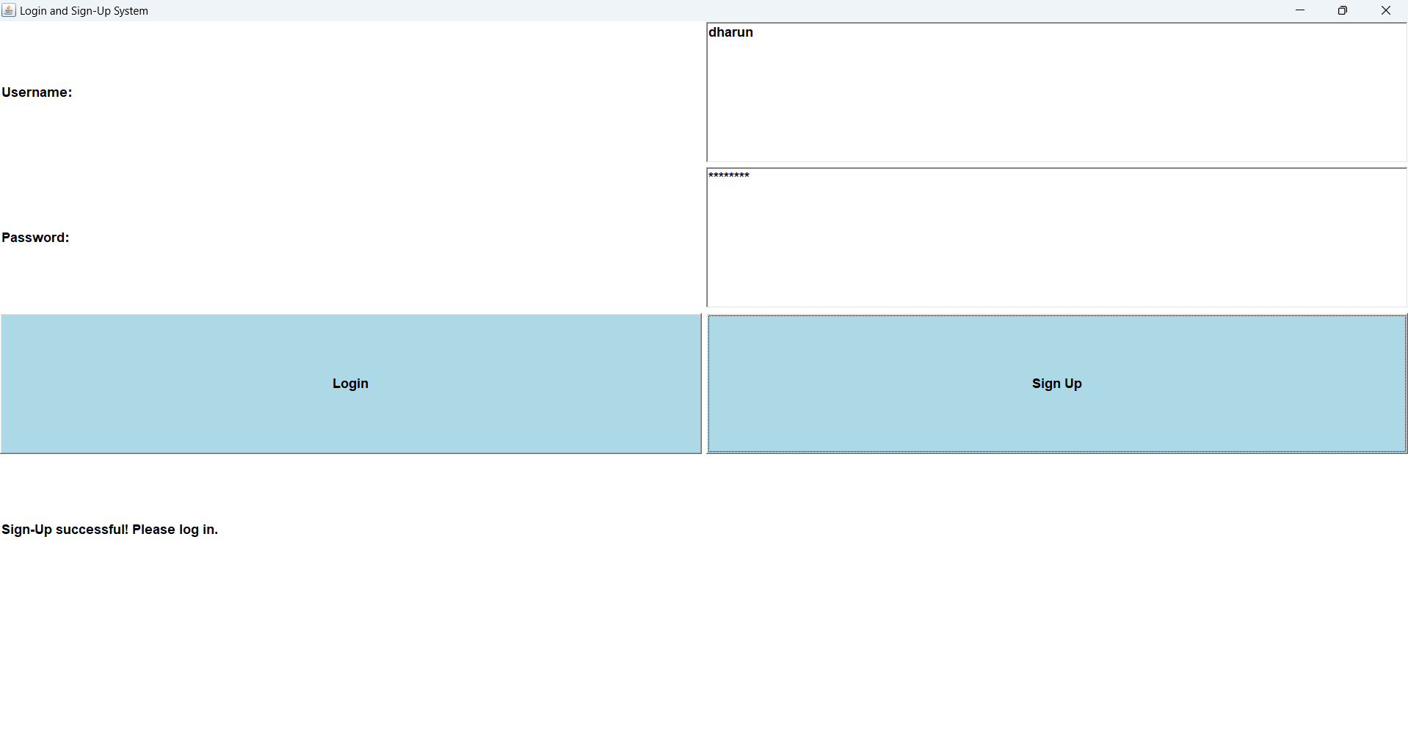
OUTPUT

Slide 9
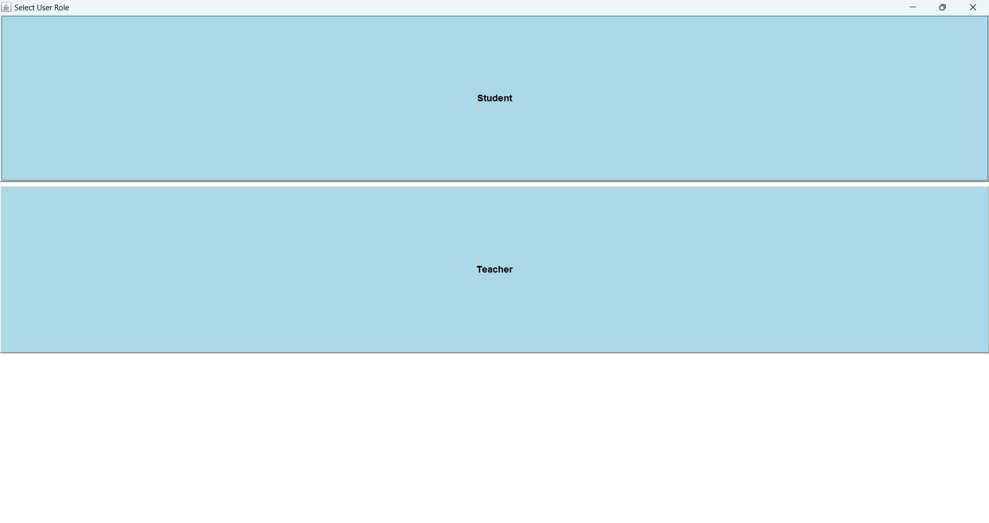

Slide 10
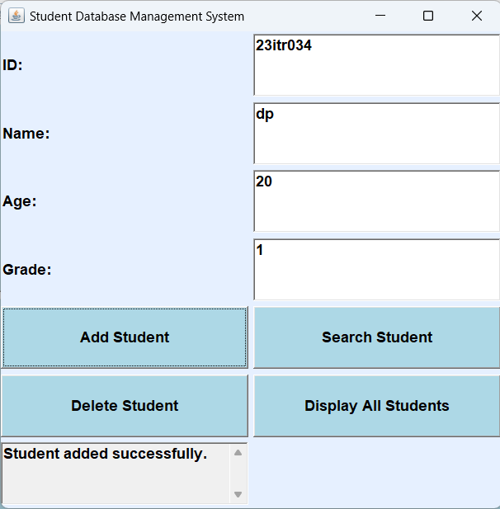
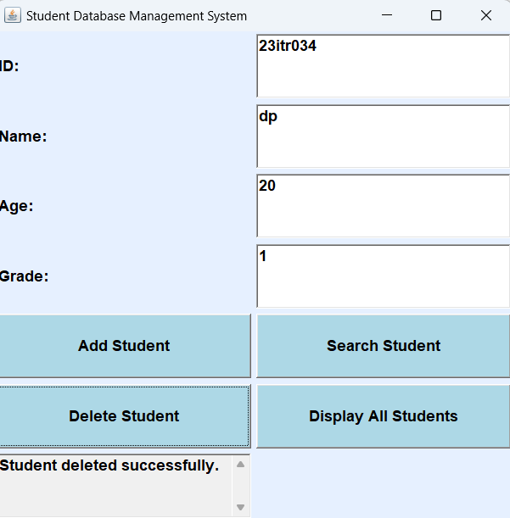

Slide 11
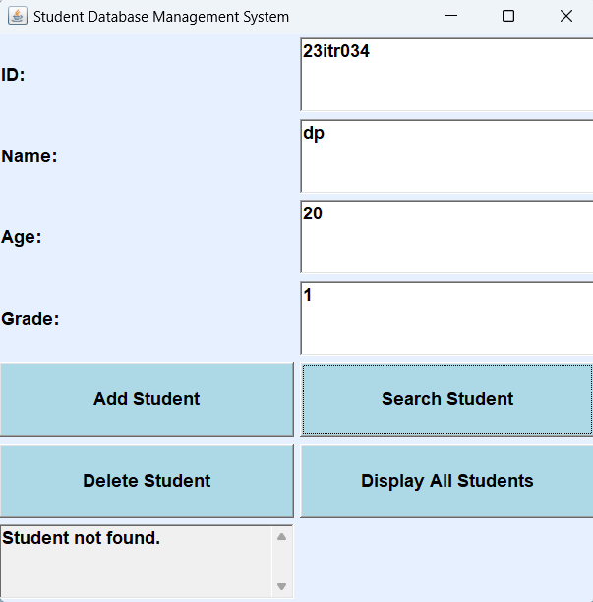
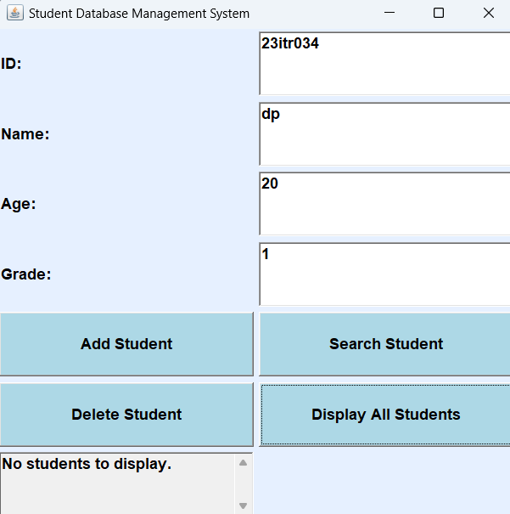

Slide 12
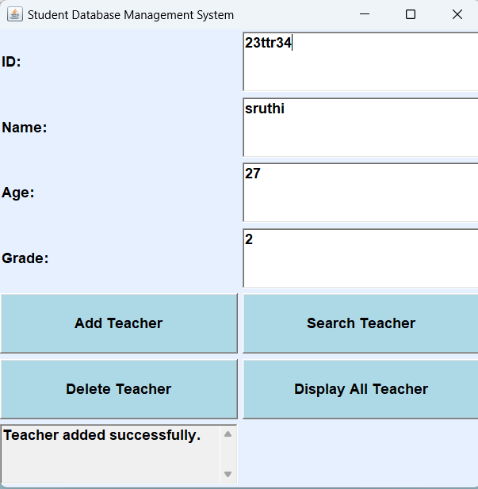

Slide 13
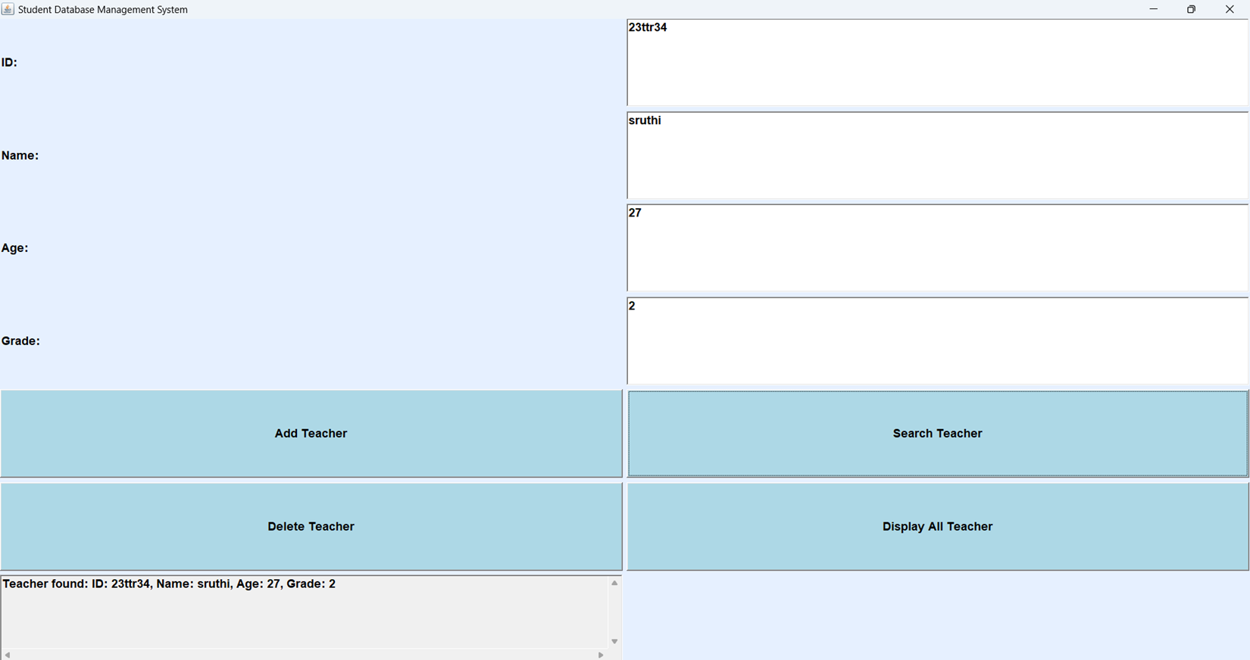

Slide 14
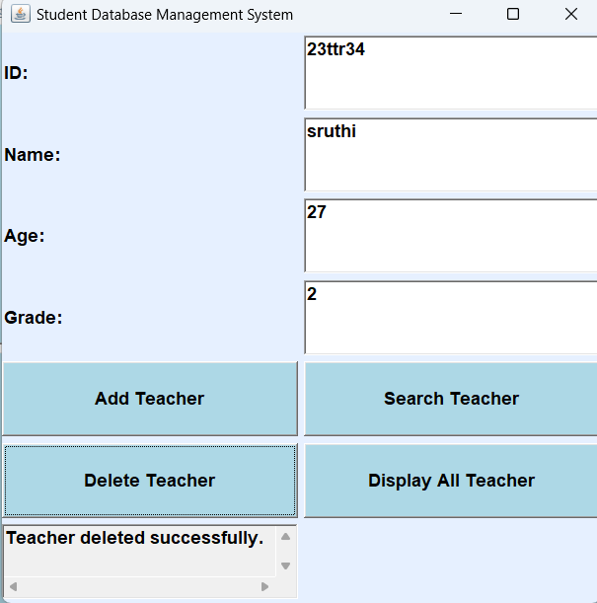

Slide 15
Thank you!

